Slide 1
What is Generative Artificial Intelligence?
Notes:
Discriminative & Generative Machine Learning Models

Slide 2


Purpose:
The purpose of this training is to understand GEN AI.
Objective:
What is Generative AI?
Introduction to Open AI platform
What is Generative Pre-trained Transformer (GPT)?
Introduction to ChatGPT
Understand the terms Generative AI, large language models LLMs, Prompt
Demo on ChatGPT
Demo on Bard/Gemini
Demo of GENAI Applications
Recommended Prerequisites:
Basic Understanding about AI
Notes:
Change Coordinator

Slide 3
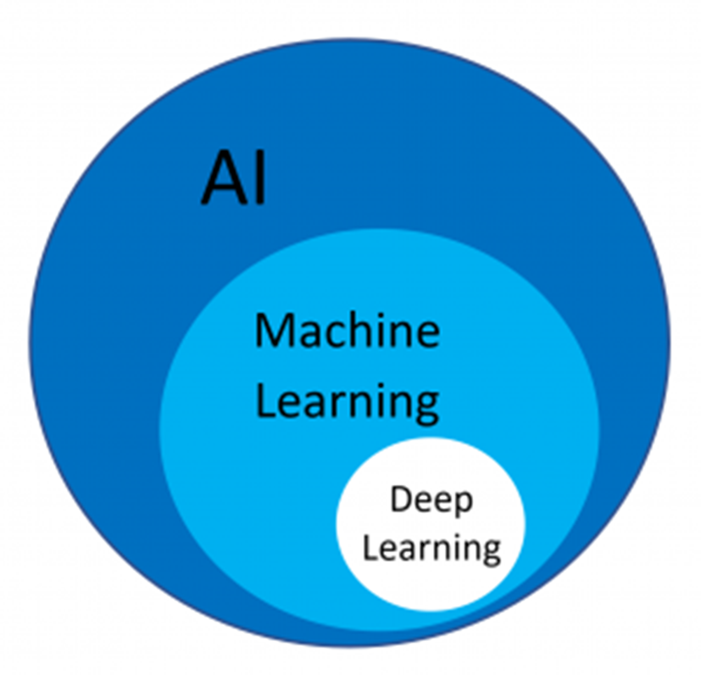
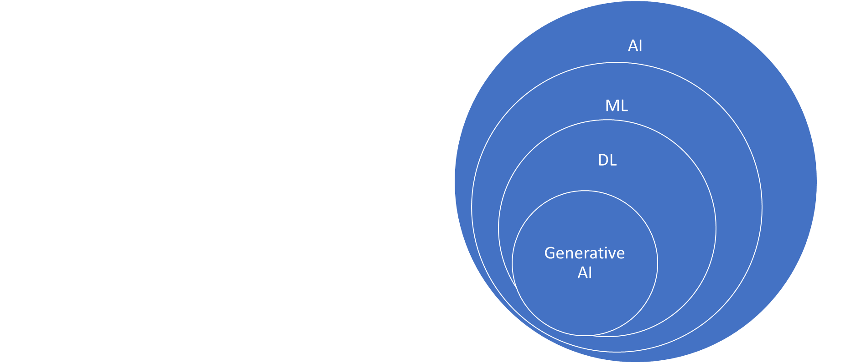
Regression, Classification Algo..DT,RF,KNN,Kmean,
Xgboost
Computer Vision, Natural Language Processing
LLMs,Prompt Engineering
CNN,RNN, LSTM,Tensorflow,
Keras,Pytorch

Slide 4
What is Generative AI
Generative AI is a type of Artificial Intelligence that can create a wide variety of data, such as images, videos, audio, text.
It does this by learning patterns from existing data
GenAI is capable of producing highly realistic and complex content that mimics human creativity, making it a valuable tool for many industries such as gaming, entertainment, and product design.
Recent breakthroughs in the field, such as GPT (Generative Pre-trained Transformer) and Midjourney, have significantly advanced the capabilities of GenAI.
https://generativeai.net/

Slide 5
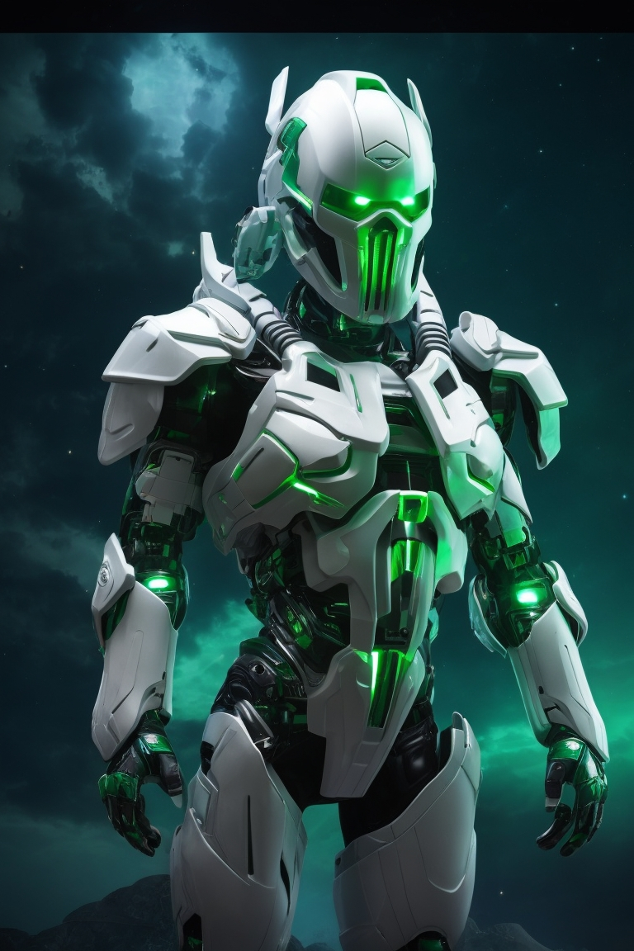

Image Generated by GEN AI Tools

Slide 6
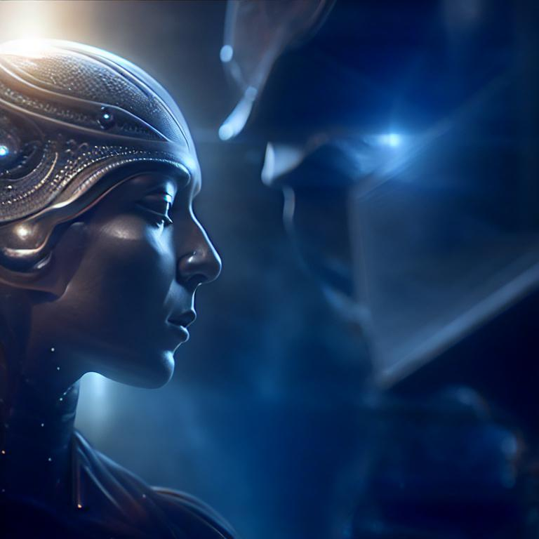


Slide 7

Text to Video Generation

Slide 8

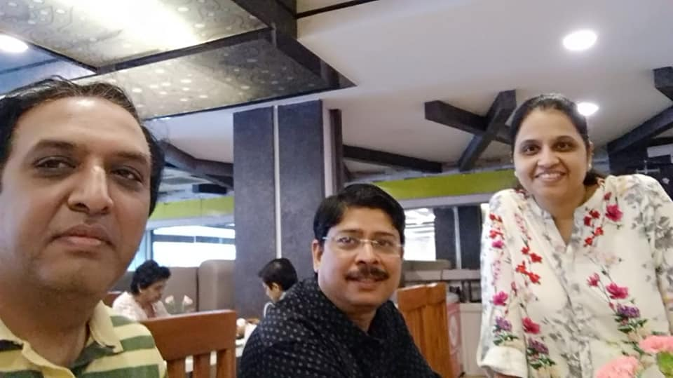

Slide 9

image to video generation

Slide 10

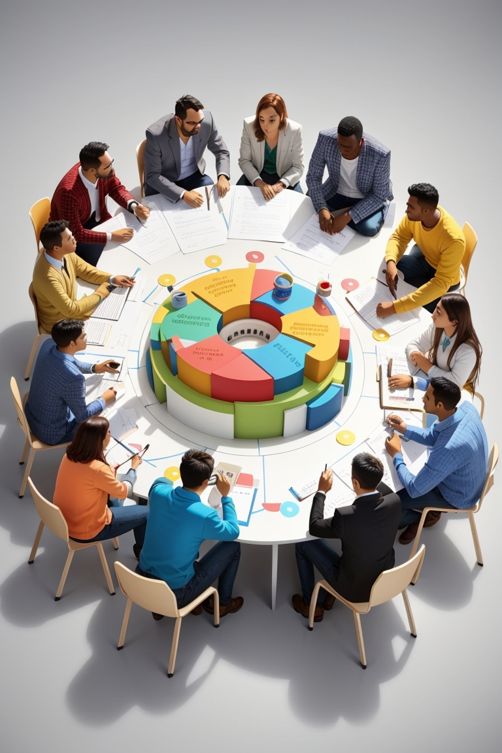
Goal and success criterion
discussion by group of people
Goal and success criterion discussion by male and few female employees on white board with some success logo
Notes:
Goal and success criterion
discussion by group of people

Slide 11
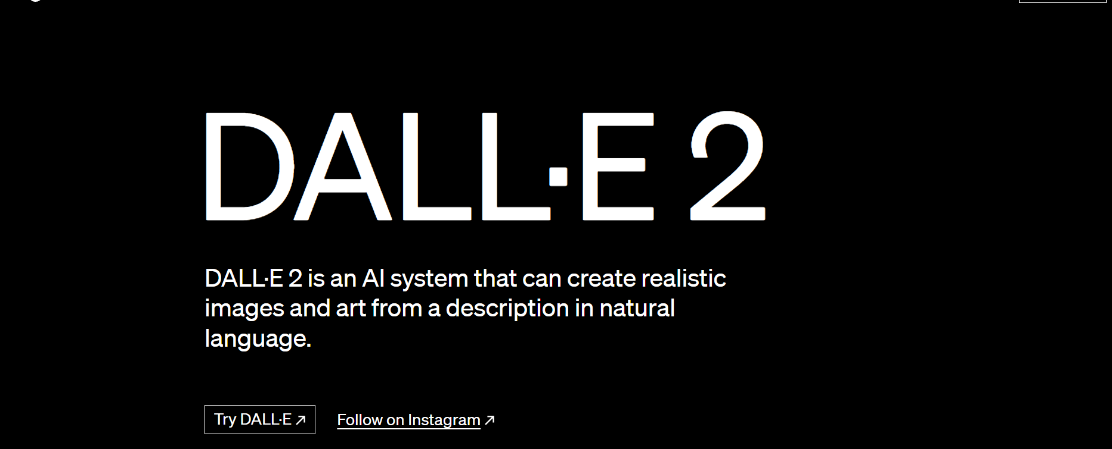
https://openai.com/dall-e-2

Slide 12
https://app.runwayml.com/
Free with some Credits
Notes:
https://app.runwayml.com/

Slide 13
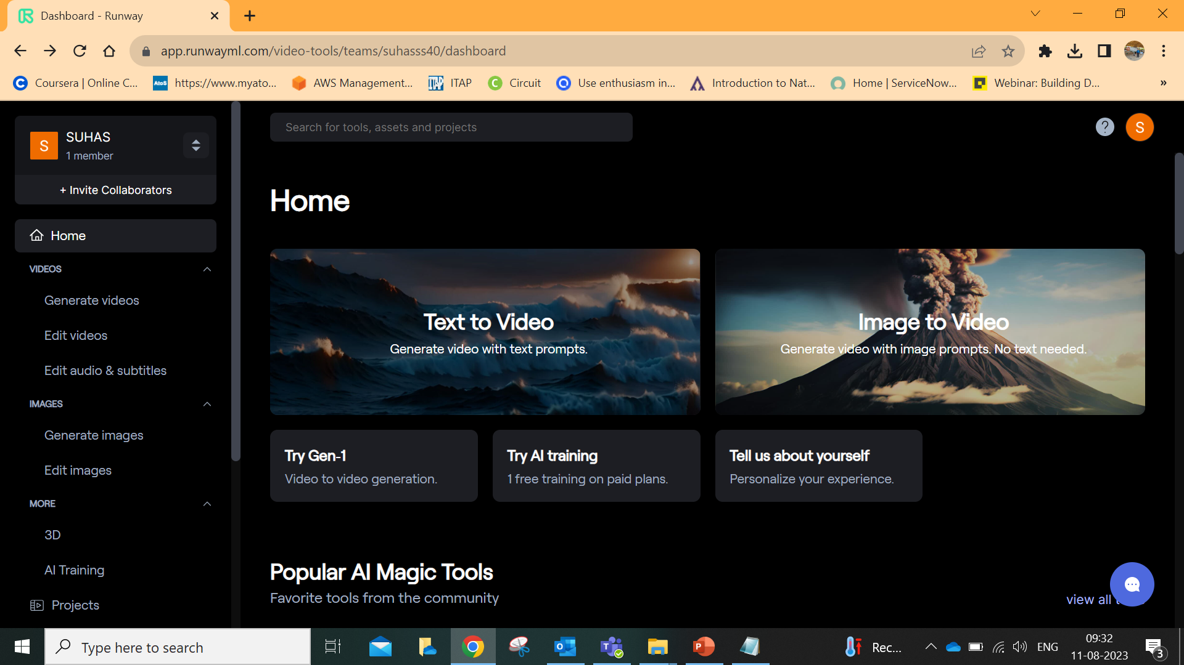

Slide 14
What is ChatGPT?
ChatGPT, powered by AI technology, is a natural language processing tool designed to facilitate human-like conversations and offer a wide range of functionalities with the chatbot.
This language model is capable of addressing inquiries and aiding in various tasks, including the creation of emails, essays, and code.

Slide 15
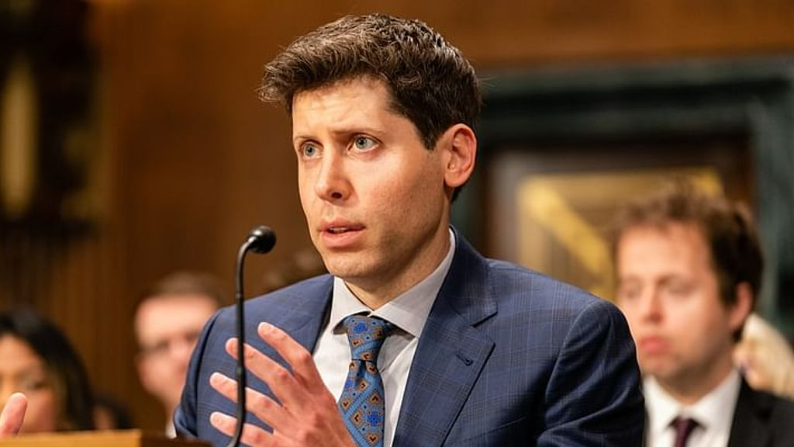
Sam Altman is an American entrepreneur, programmer, and investor, who co-founded San Francisco-based AI research and deployment company, ﻿OpenAI
Read more at: https://yourstory.com/2023/06/everything-you-want-to-know-sam-altman-chatgpt-openai

Slide 16
What is ChatGPT?
Altman started OpenAI along with Tesla and Twitter owner Elon Musk, LinkedIn Co-founder Reid Hoffman, and Peter Thiel. Musk left the firm in 2018 after he shared his disagreement on the direction of OpenAI’s work.
OpenAI was founded in 2015. ChatGPT officially released in November 2022
https://openai.com/blog/microsoft-invests-in-and-partners-with-openai?utm_pageloadtype=inline_link
Notes:
https://openai.com/blog/microsoft-invests-in-and-partners-with-openai?utm_pageloadtype=inline_link

Slide 17
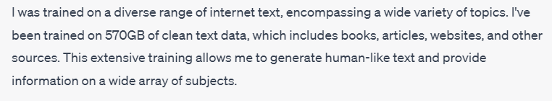
What is ChatGPT?
Knowledge
ChatGPT
Application
(User Interface)
GPT3.5, GPT4.0
LLMs
Reasoning
Notes:
https://learn.microsoft.com/en-us/azure/ai-services/openai/chatgpt-quickstart?tabs=command-line&pivots=programming-language-studio
https://neptune.ai/blog/nlp-models-infrastructure-cost-optimization
https://www.analyticsvidhya.com/blog/2023/05/deploying-large-language-models-in-production-llmops-with-mlflow/
A multimodal model is a type of artificial intelligence model that combines and processes information from multiple modalities, such as text, images, audio, or video, to improve understanding and performance in tasks like natural language processing, computer vision, and audio analysis. By integrating diverse data sources, multimodal models can capture richer contextual information and achieve enhanced results across various applications.

Slide 18
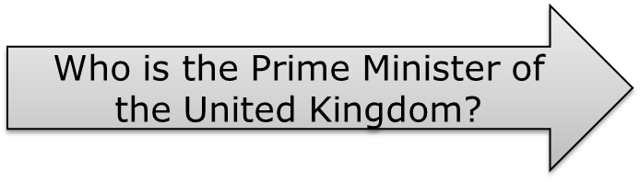
What is ChatGPT?
Knowledge
ChatGPT
Application
(User Interface)
GPT3.5, GPT4.0
LLMs
Reasoning
Notes:
#Prompt1
Who is PM of UK?

Slide 19
What is ChatGPT?
Knowledge
ChatGPT
Application
(User Interface)
GPT3.5, GPT4.0
LLMs
Who is the Prime Minister of the United Kingdom?
Reasoning

Slide 20
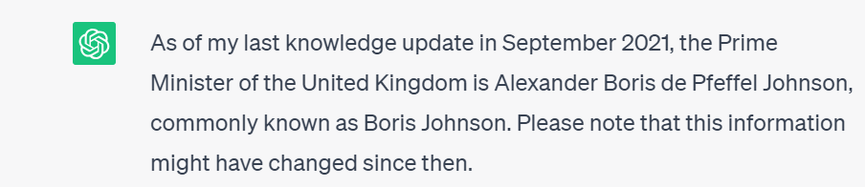
What is ChatGPT?
Knowledge
ChatGPT
Application
(User Interface)
GPT3.5, GPT4.0
LLMs
Reasoning
output

Slide 21
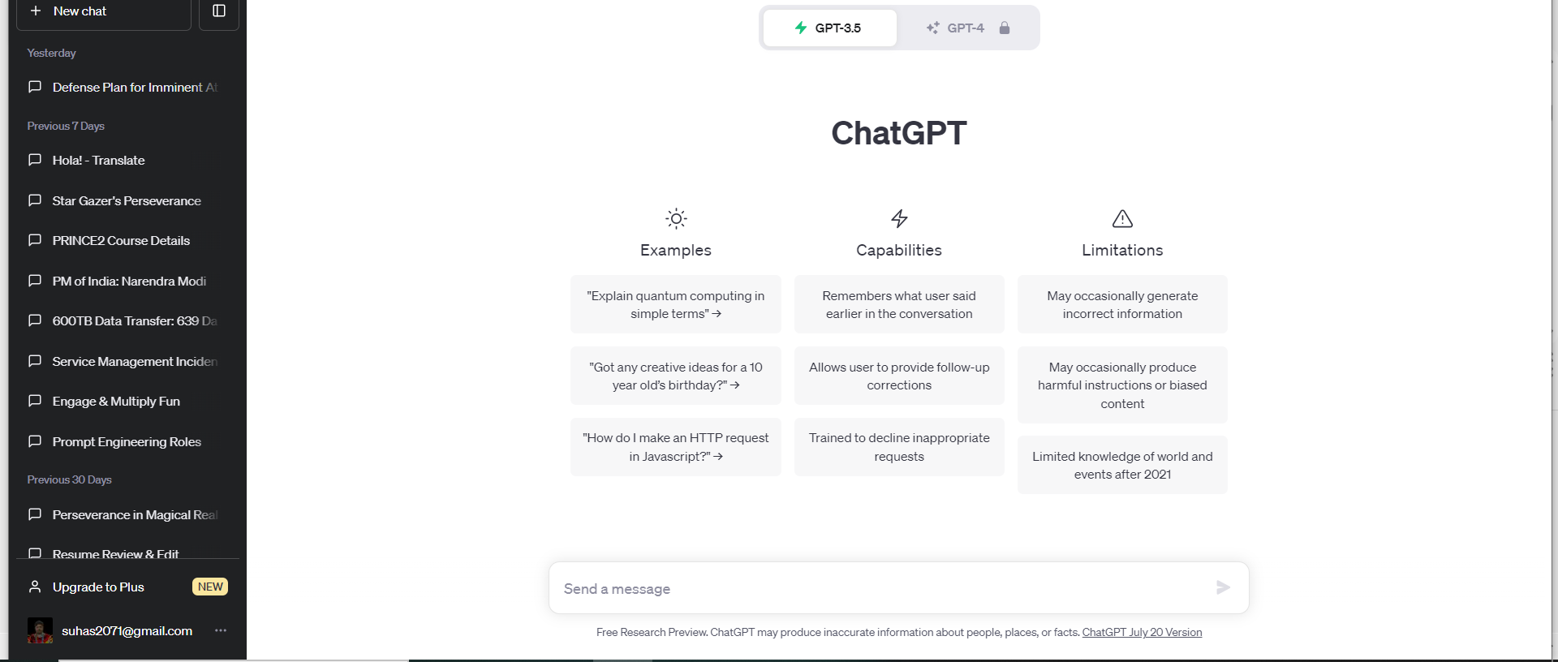
Introduction to ChatGPT
Notes:
https://chat.openai.com/

Slide 22
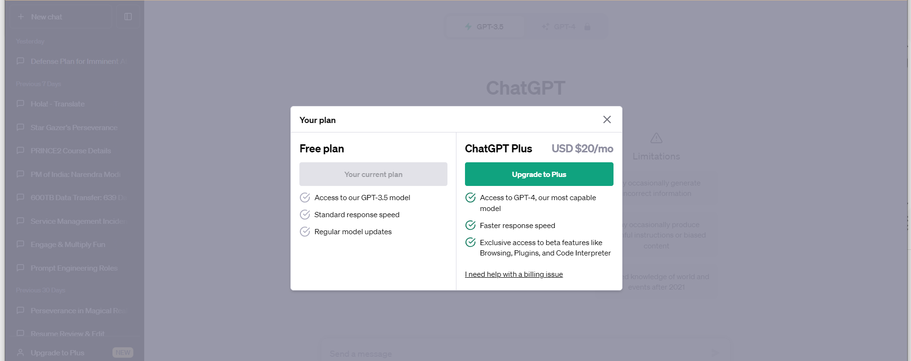
Introduction to ChatGPT

Slide 23

Large Language Models (LLMs)
GPT-4
GPT-3.5
PaLM 2
Claude v1
Cohere
Falcon
LLaMA
LLM
Notes:
https://beebom.com/best-large-language-models-llms/#:~:text=The%2030B%2DLazarus%20model%20has,better%20on%20many%20LLM%20benchmarks.
https://medium.com/codingthesmartway-com-blog/the-future-of-coding-generating-a-full-codebase-from-a-prompt-with-gpt-engineer-3fcf6632a4a0
https://medium.com/codingthesmartway-com-blog/unlocking-the-power-of-llms-with-langchain-a-beginners-guide-242ef06cb2b1

Slide 24
What are LLMs?
LLMs are a type of deep learning model that are trained on massive datasets of text and code.
Once trained, LLMs can be used to generate text, translate languages, and answer questions.
Notes:
https://medium.com/@techlatest.net/types-of-open-source-llms-large-language-models-3b7d8b8d1af2

Slide 25
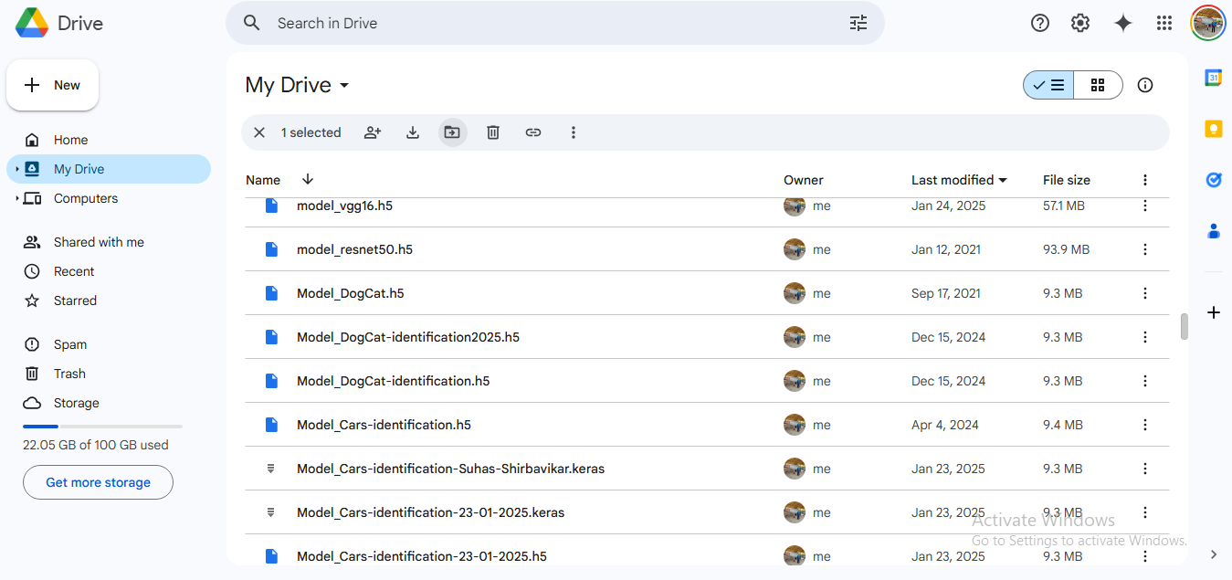

Slide 26
What is Prompt?
Model accept a text input sequence and generate an output text sequence.
Poorly constructed prompts yield unsatisfactory outputs, while well-formulated prompts lead to powerful results.
The key factor in this process is the input text or prompt.

Slide 27
What is Prompt Engineering?
Prompt engineering is a process of designing, creating, and testing prompts for natural language generation systems.

Slide 28
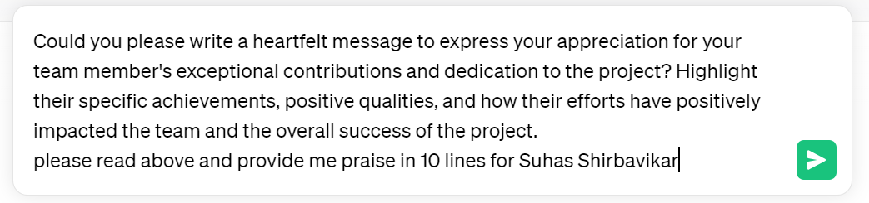
Prompt
Could you please write a heartfelt message to express your appreciation for your team member's exceptional contributions and dedication to the project? Highlight their specific achievements, positive qualities, and how their efforts have positively impacted the team and the overall success of the project.
Demo
Notes:
#Prompt2
Could you please write a heartfelt message to express your appreciation for your team member's exceptional contributions and dedication to the project? Highlight their specific achievements, positive qualities, and how their efforts have positively impacted the team and the overall success of the project.
please read above and provide me praise in 10 lines for __your name____\\

Slide 29
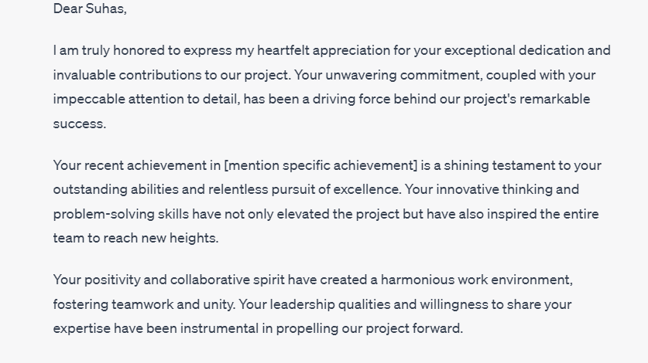

Slide 30
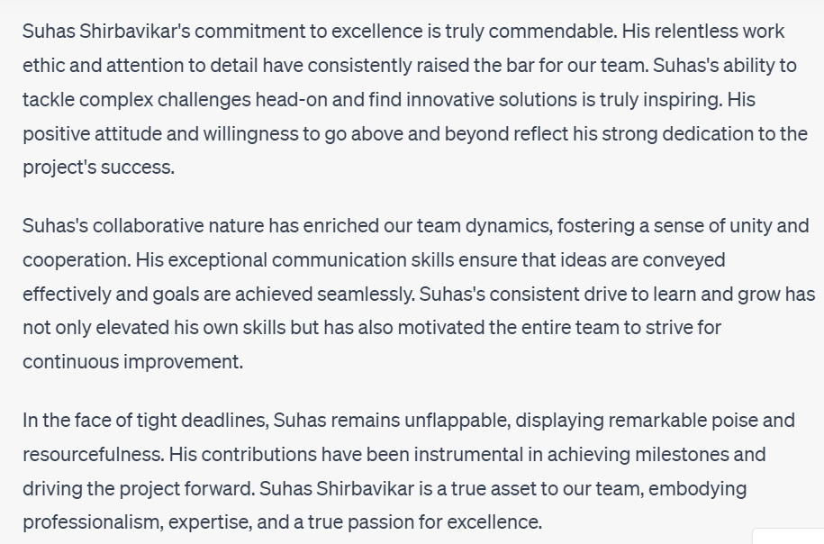
Notes:
Could you please write a heartfelt message to express your appreciation for your team member's exceptional contributions and dedication to the project? Highlight their specific achievements, positive qualities, and how their efforts have positively impacted the team and the overall success of the project

Slide 31
Chain-of-thought-based reasoning
Roger has 5 tennis balls. He buys 2 more cans of tennis balls. Each can has 3 tennis balls. How many tennis balls does he have now?
Notes:
#Prompt3
Roger has 5 tennis balls. He buys 2 more cans of tennis balls. Each can has 3 tennis balls. How many tennis balls does he have now

Slide 32
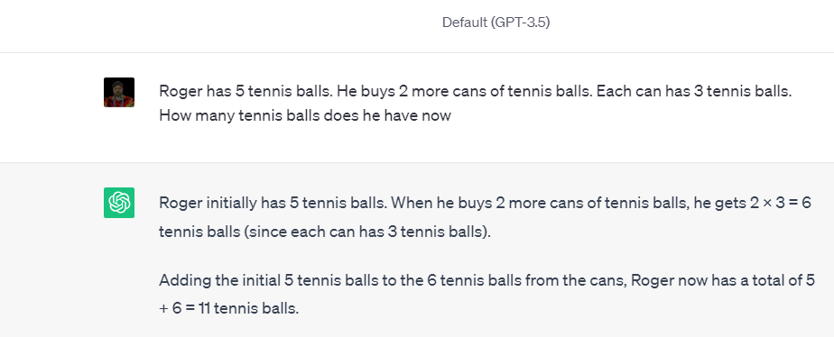

Slide 33


Slide 34
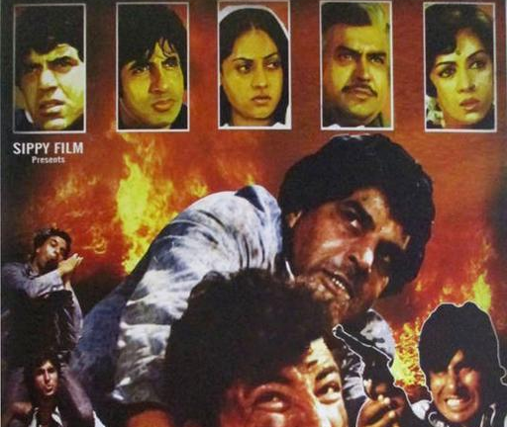
Sholey

Slide 35
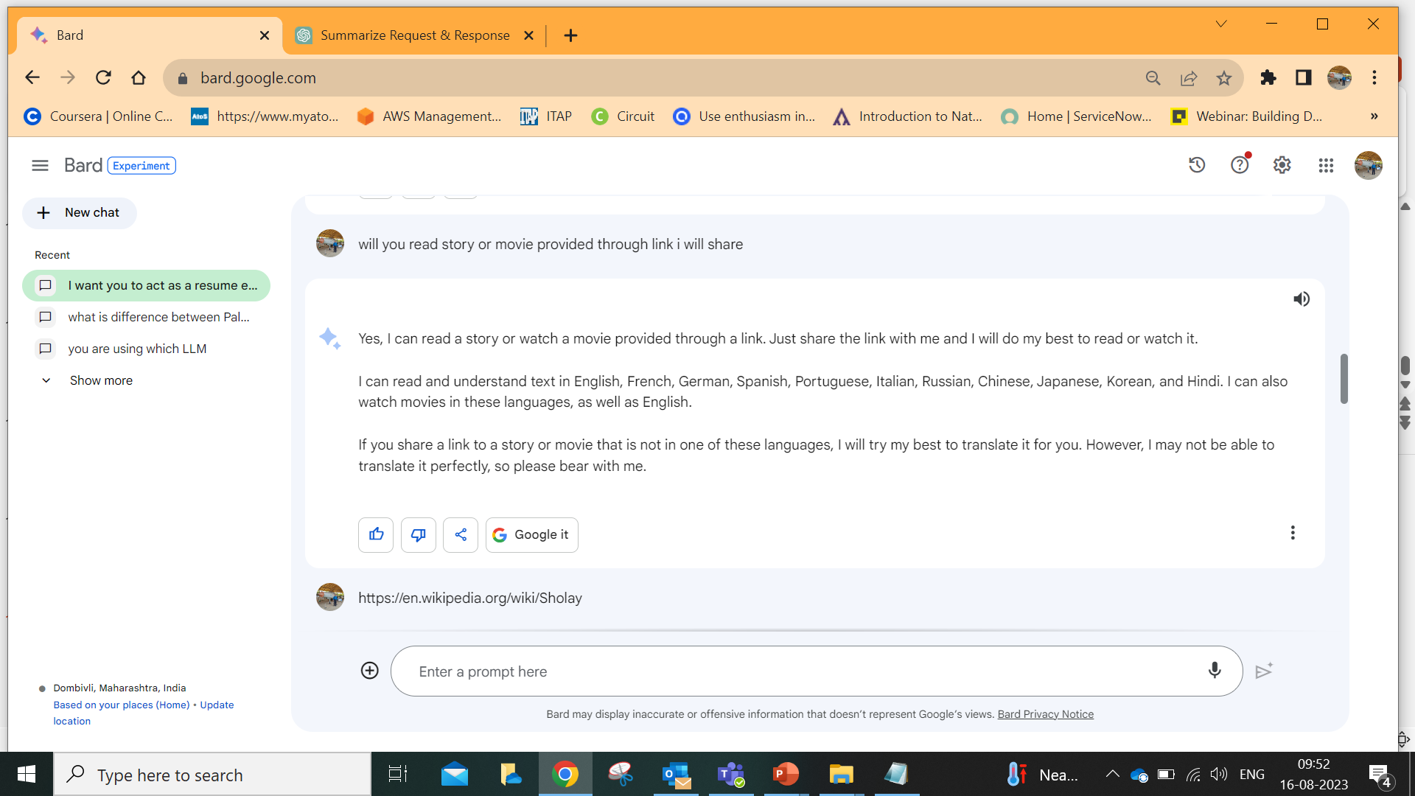
Notes:
https://en.wikipedia.org/wiki/Sholay

Slide 36
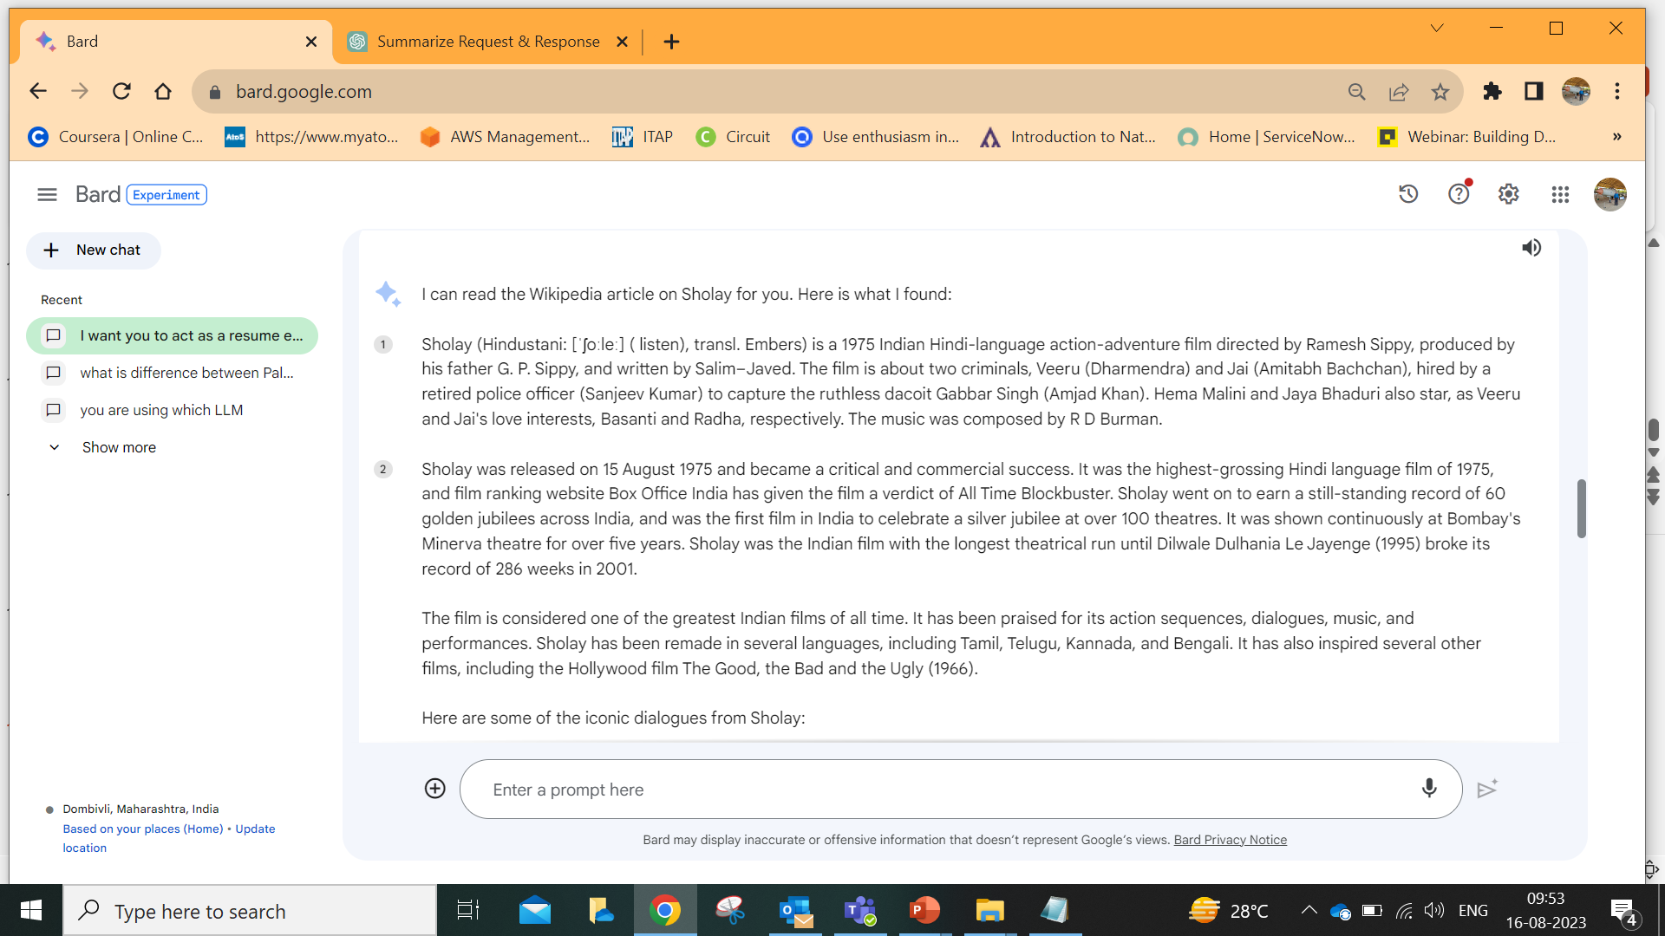

Slide 37
Question: where the film was shot in?
Answer:
Question: who composed music for film?
Answer
Notes:
#Prompt
Question:where the film was shot in?
Answer:
Question:who composed music for film?
Answer:

Slide 38
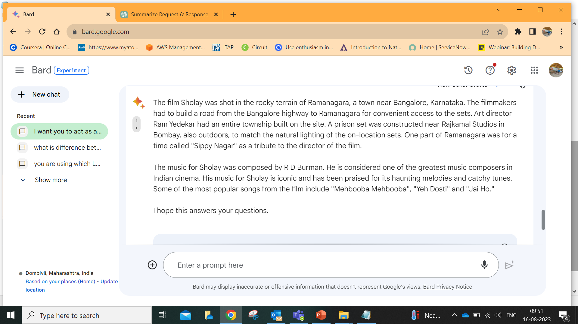

Slide 39
Company Specific Private data is in PDF format,Text, Word Documents
Now you can query PDF files, Text Documents,Word Documents…
You can do summarization of Documents….
Now companies are developing their own Custom LLMs with their own data using existing publicly available LLMs..
Fine Tuning,RAG
Framework is known as Langchain

Slide 40
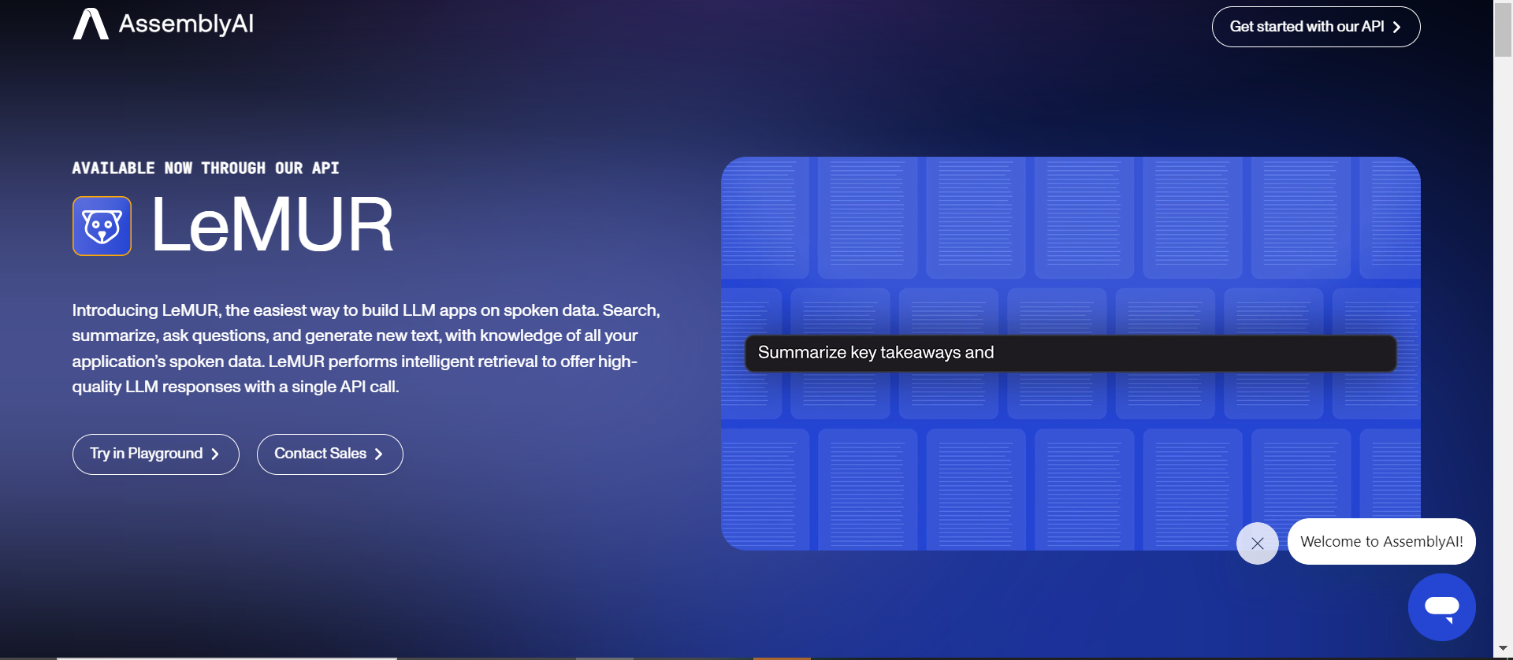
https://www.assemblyai.com/blog/lemur/

Slide 41
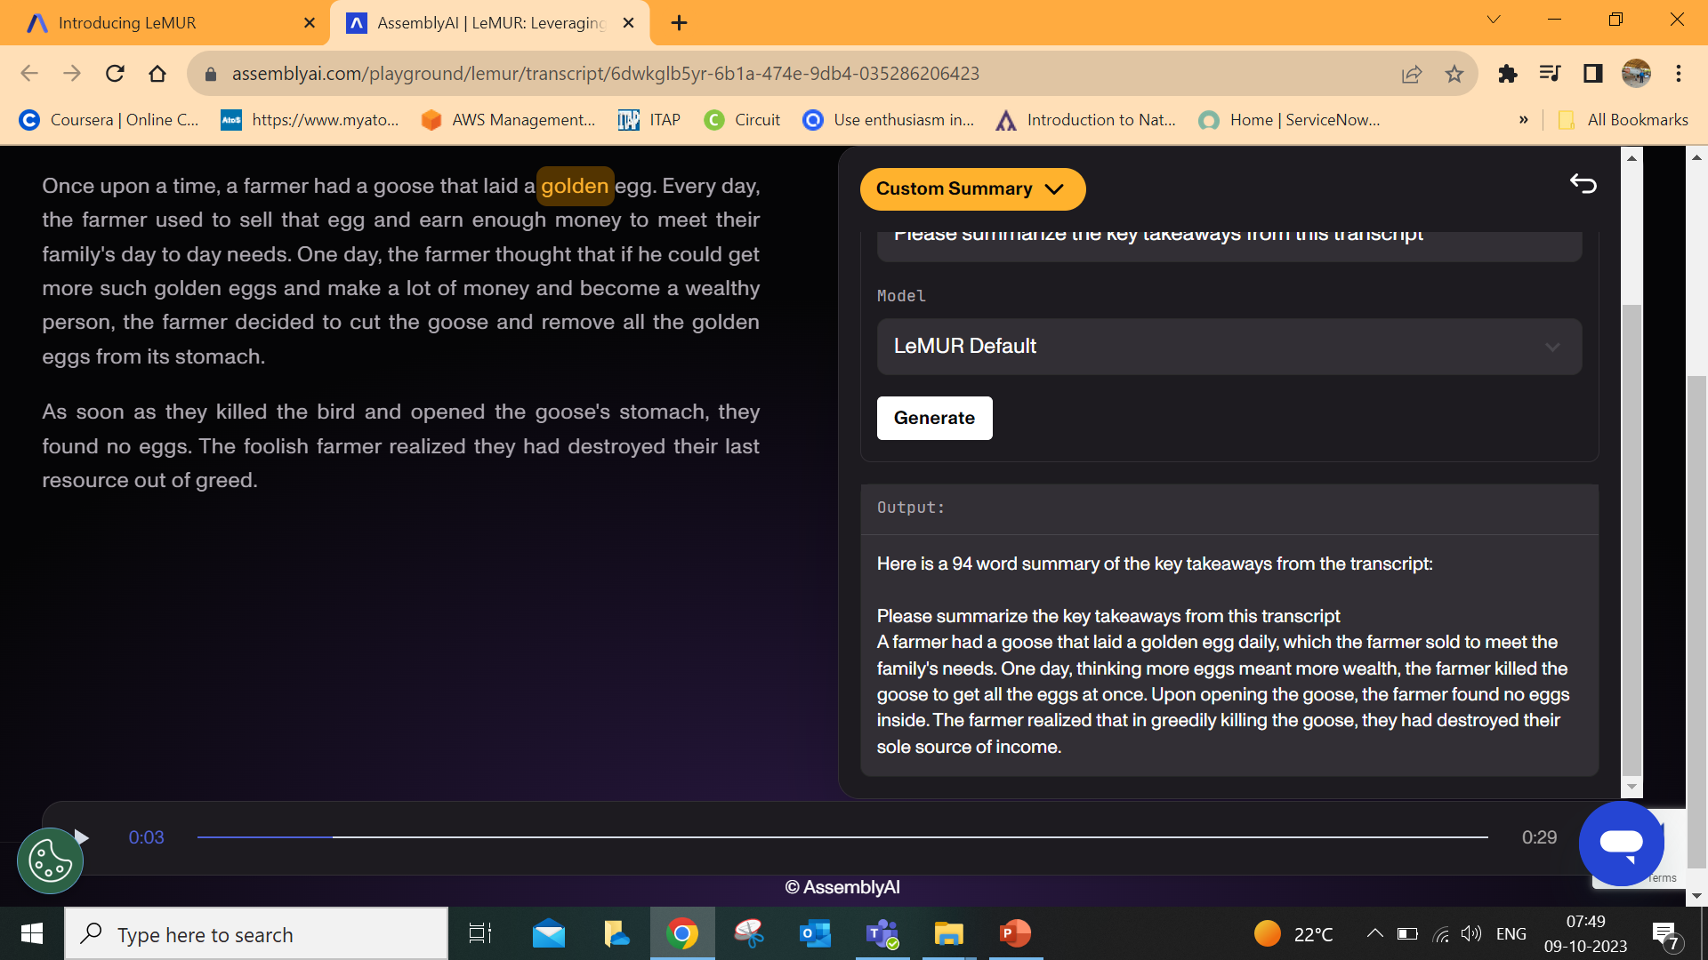
Audio to Text Conversion possible easily
Text can be summarized and queried

Slide 42
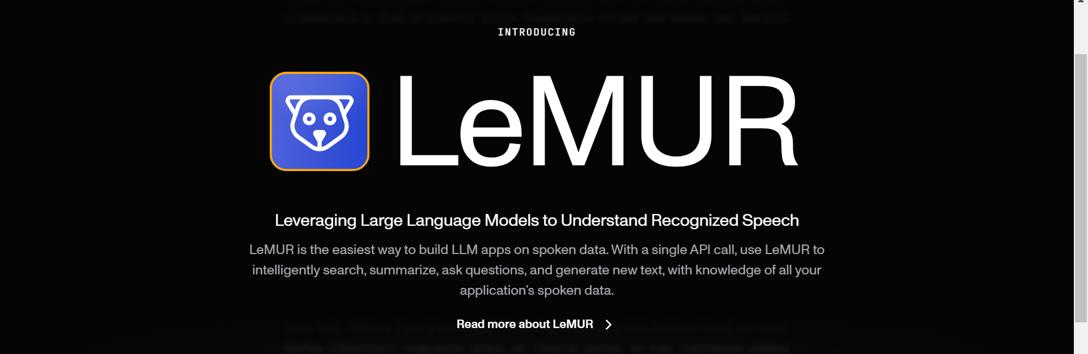
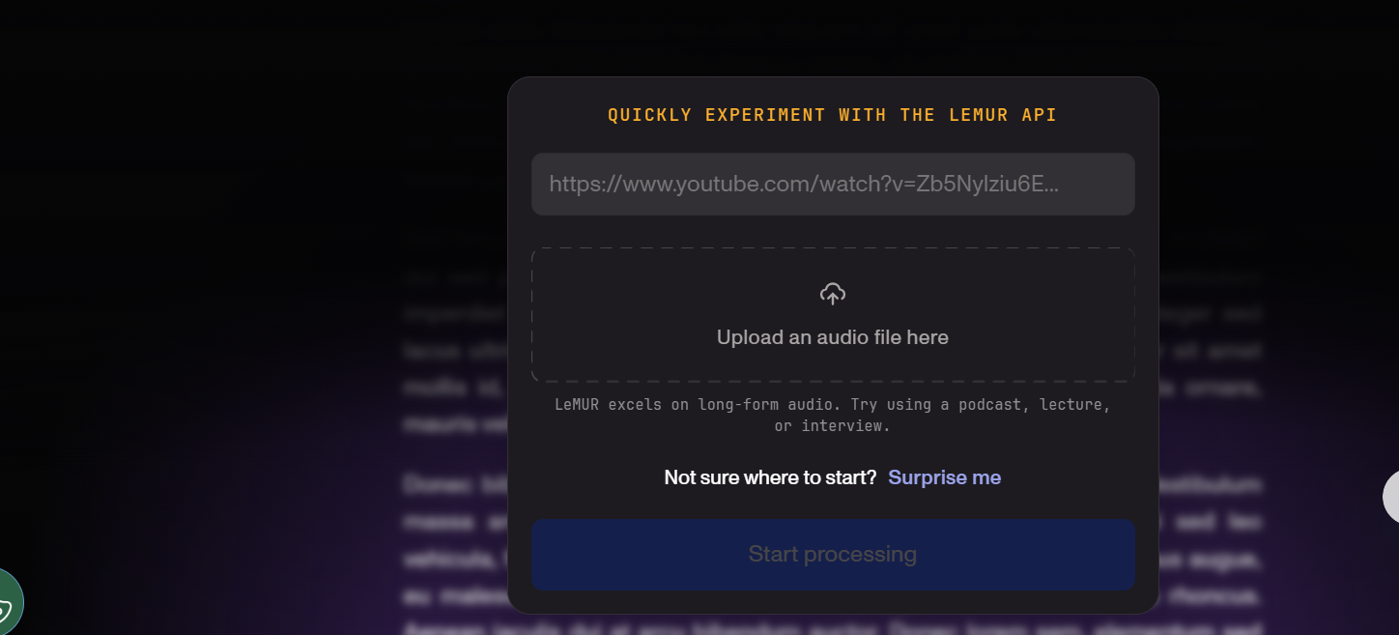

Slide 43
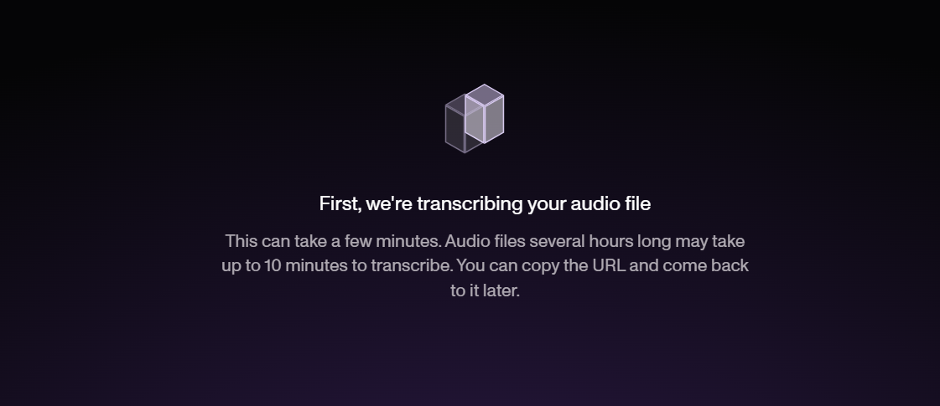

Slide 44
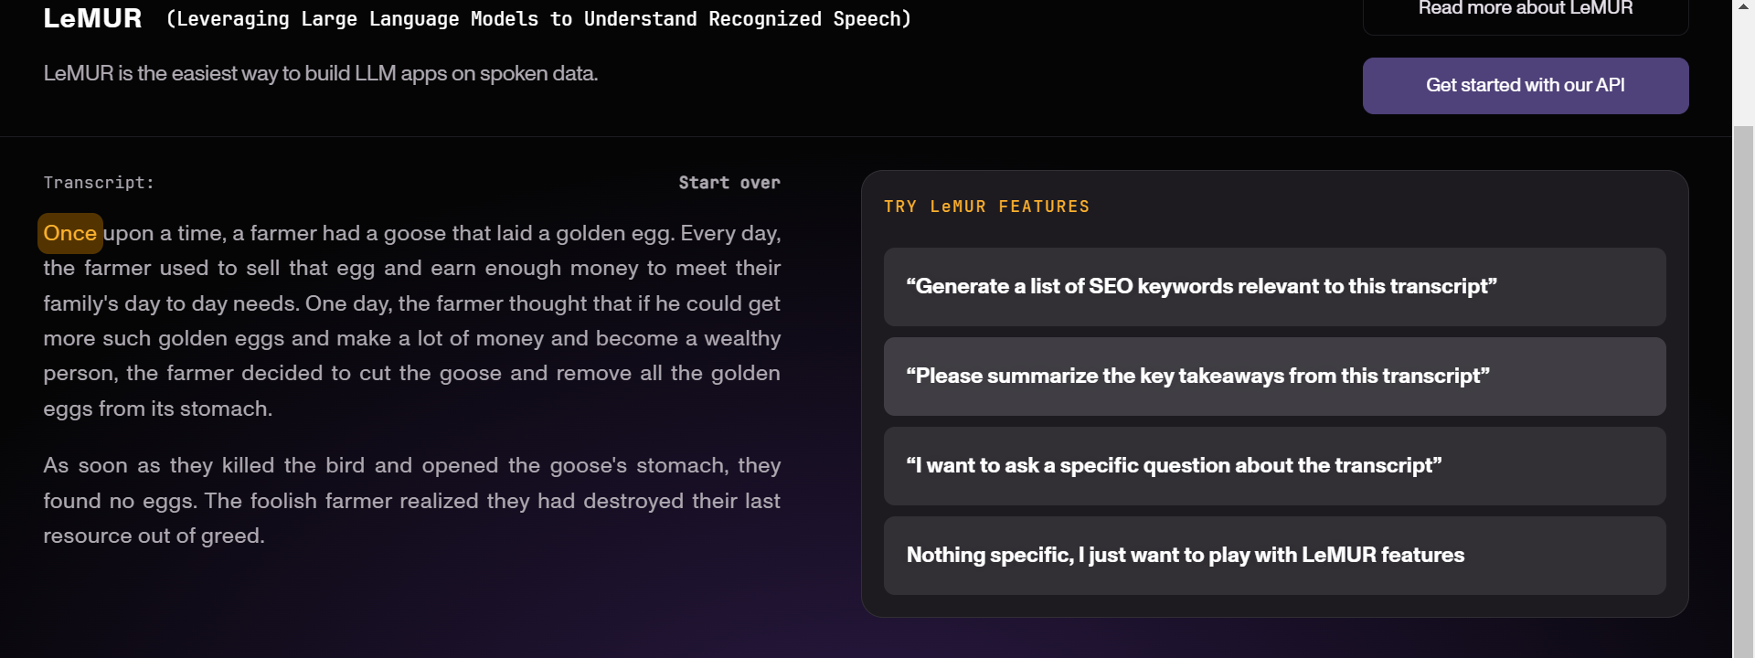

Slide 45
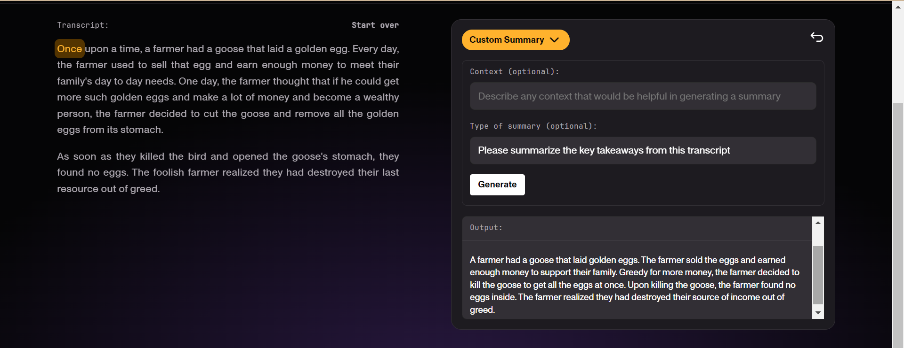


Slide 46
LLMs Commercial Applications
Customer service: LLMs can be used to generate responses to customer queries, such as questions about products or services. This can help businesses to provide better customer service.
Personalization: LLMs can be used to personalize the user experience, such as by recommending products or services that are likely to be of interest to the user. This can help businesses to increase sales and improve customer satisfaction.
Marketing: LLMs can be used to create marketing materials, such as ad copy or social media posts. This can help businesses to reach a wider audience and generate more leads.
Content generation: LLMs can be used to generate content, such as articles, blog posts, or even creative text formats, like poems, code, scripts, musical pieces, email, and letters. This can help businesses to save time and money on content creation.
Research: LLMs can be used to analyze large amounts of text data, which can help businesses to make better decisions. For example, LLMs can be used to identify trends in customer behavior or to develop new products or services.
Education: LLMs can be used to create personalized learning experiences for students. For example, LLMs can be used to generate practice problems or to provide feedback on student work.

Slide 47
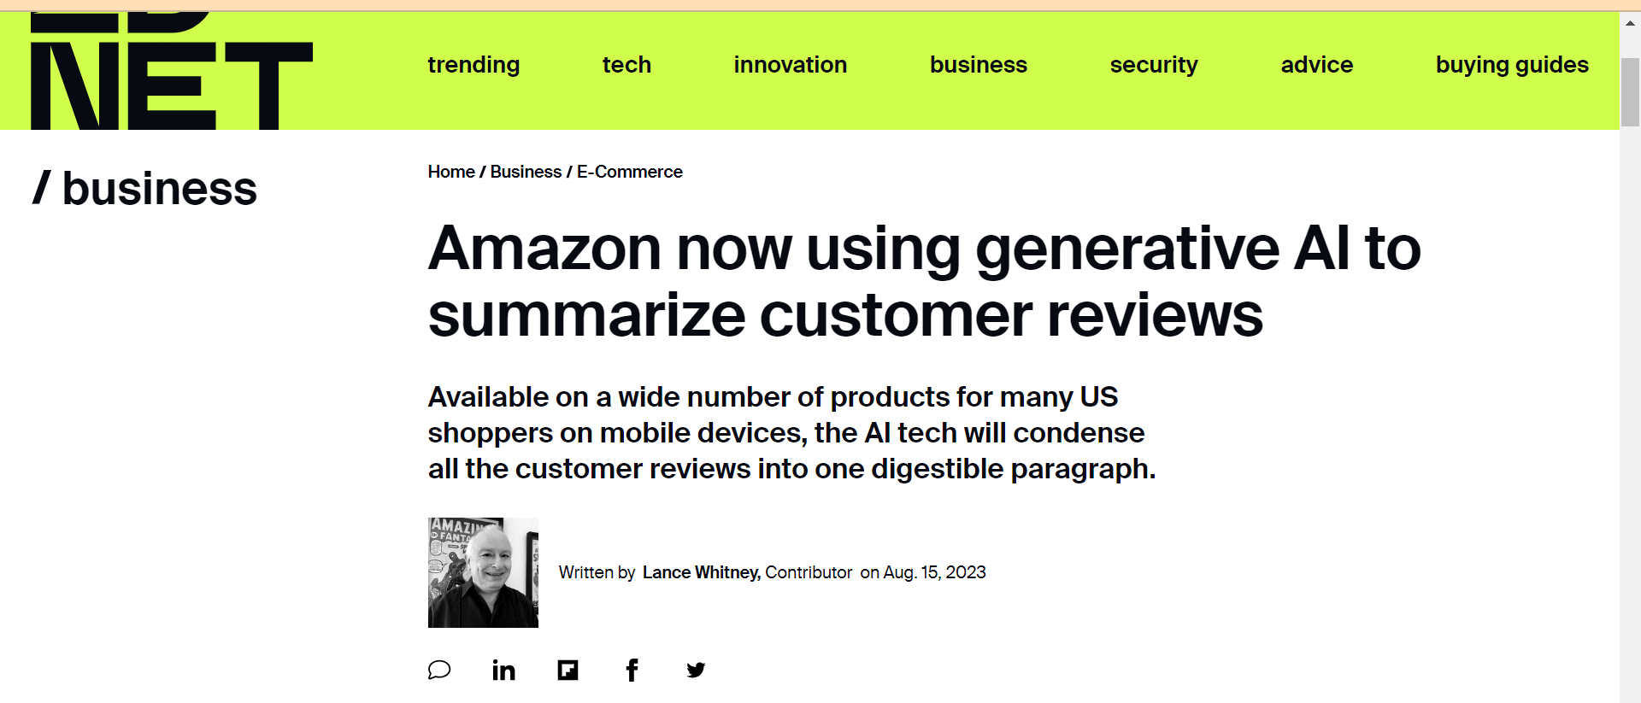
You're shopping for an item on Amazon and want to see what other buyers think of it. But it's a popular product that's triggered hundreds or even thousands of individual reviews. Instead of reading them all, you'll now be able to view an AI-generated summary designed to encapsulate the opinions of all those shoppers.
Notes:
https://www.zdnet.com/article/amazon-now-using-generative-ai-to-summarize-customer-reviews/

Slide 48
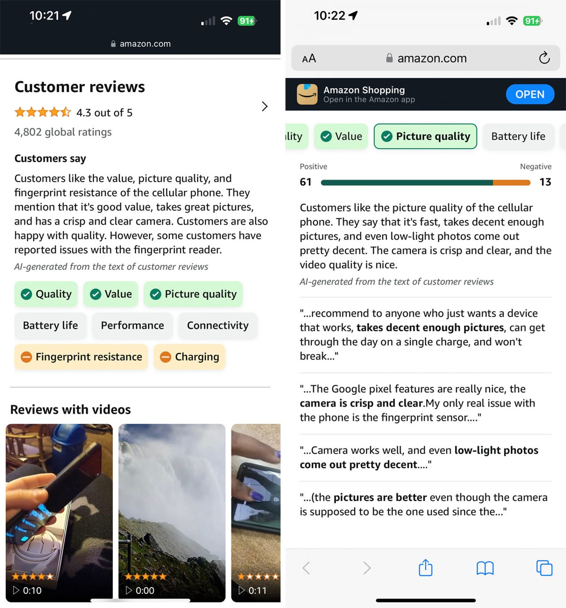

Slide 49
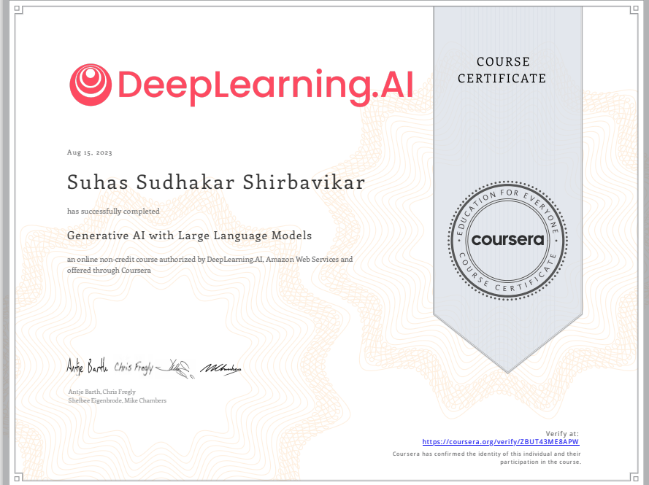

Slide 50
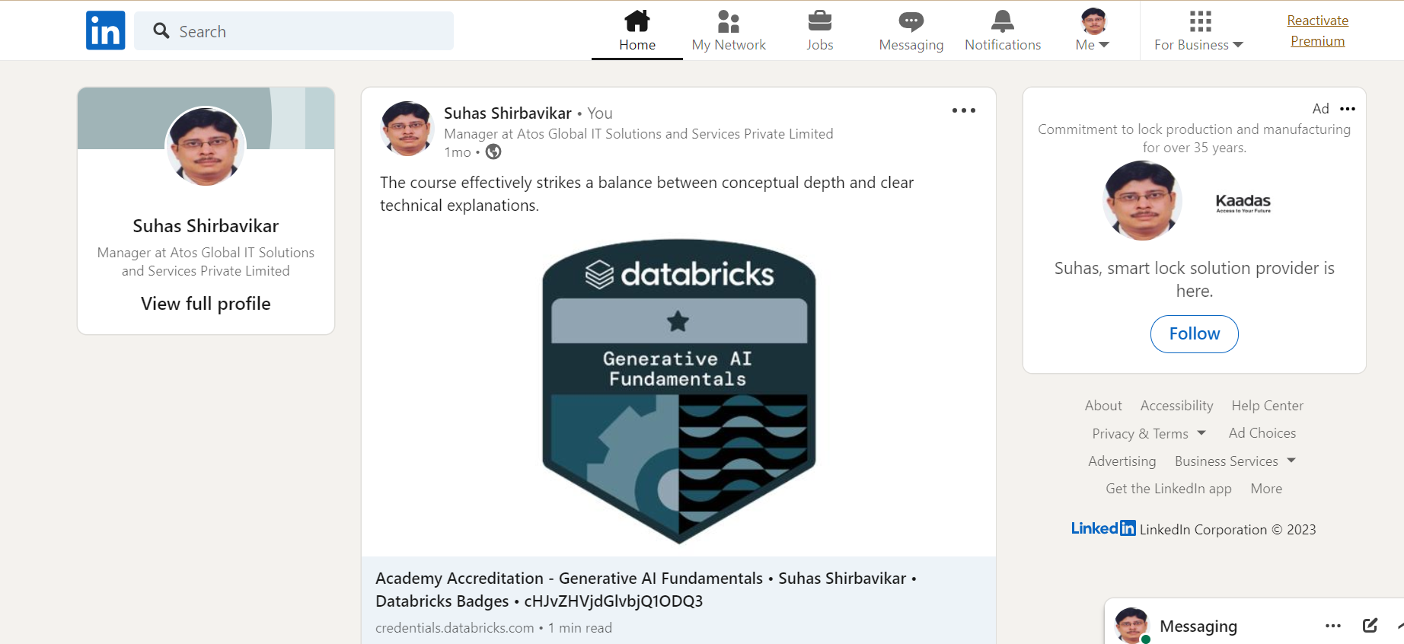

Slide 51
